Slide 1
Software for analyzing Networks
Victoria Chu

Slide 2
Set up Gephi
Download the tar at https://gephi.org/
Cd PATH/bin, then ./gephi if you’re on linux.

Slide 3
Software for analyzing networks
Depending on your social networking needs you can choose from a long list of tools.
Some are more biology based, some are more geared towards coding, and some are more research based.
Centrifuge, Commetrix, Cuttlefish, Cytoscape, Egonet, Graphtool, GraphChi, GraphViz, Pajek
I like to use bokeh and d3
https://www.kdnuggets.com/2015/06/top-30-social-network-analysis-visualization-tools.html
Today we’ll be looking at Gephi

Slide 4
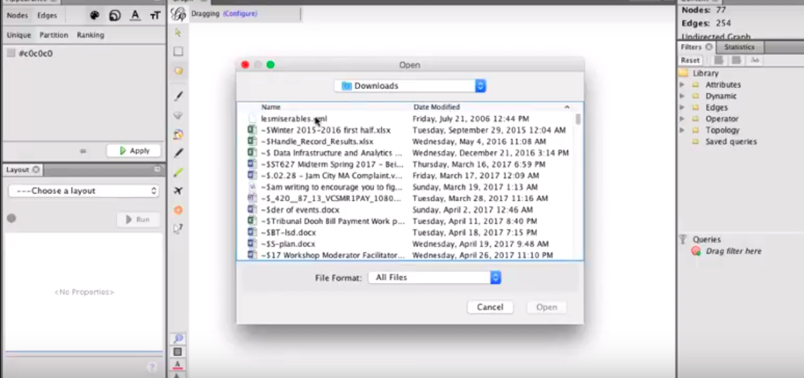
Importing graphs
Download datasets from https://github.com/gephi/gephi/wiki/Datasets
File > Open

Slide 5
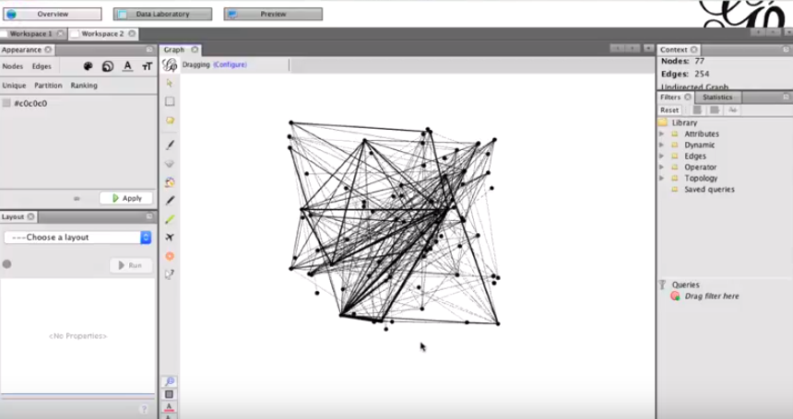
Positioning
Use the scroll wheel
Click the magnifying glass to recenter

Slide 6
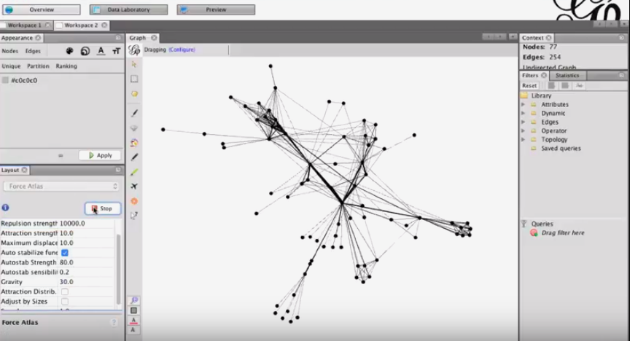
Reconfiguring the graph
Change the layout to Force Atlas
Change graph settings and hit run, hit stop when you are done with changes
For instance, here we change repulsion strength which makes the graph more spread out

Slide 7
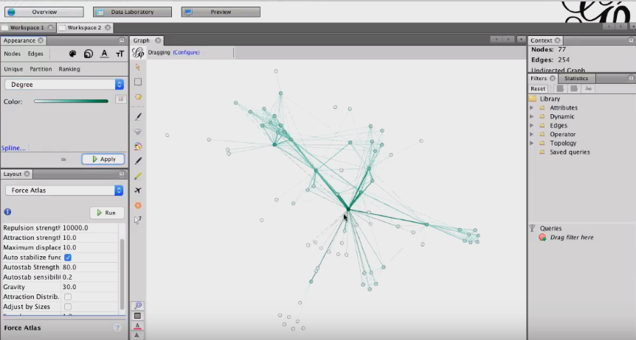
Coloring
Click on Nodes>ranked
Set the options box to degree
You can color your map so the higher degree nodes have a darker color
If you want you can change the colors by draggin arrows on the color bar when moused over and clicking the button next to the color abr which gives more options

Slide 8
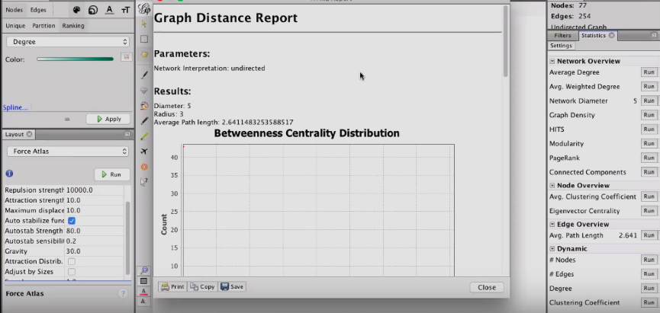
Stats for your graph
So to the right there is a tab called statistics on the right panel
You can see a bunch of terms we have been using like the average degree, diameter, pagerank, connected components, average clustering coefficient, etc.
You can hit run to get a report of the stat that you want on the graph
And then you can use it to color your graph on the left

Slide 9
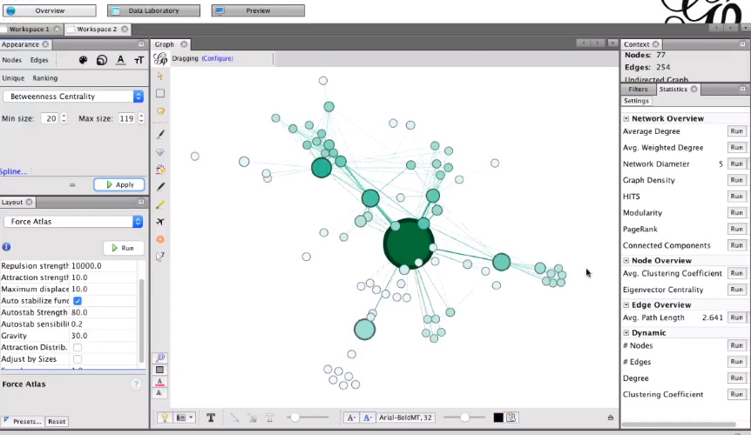
Like so:
Click size (three concentric circles)
You can set the min and max size to whatever you want

Slide 10
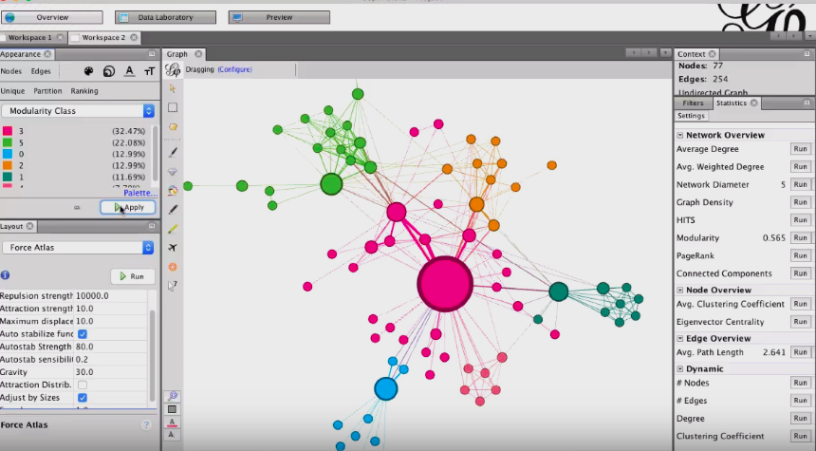
Partition coloring
Click coloring >partition> select modularity class, set colors, hit apply

Slide 11
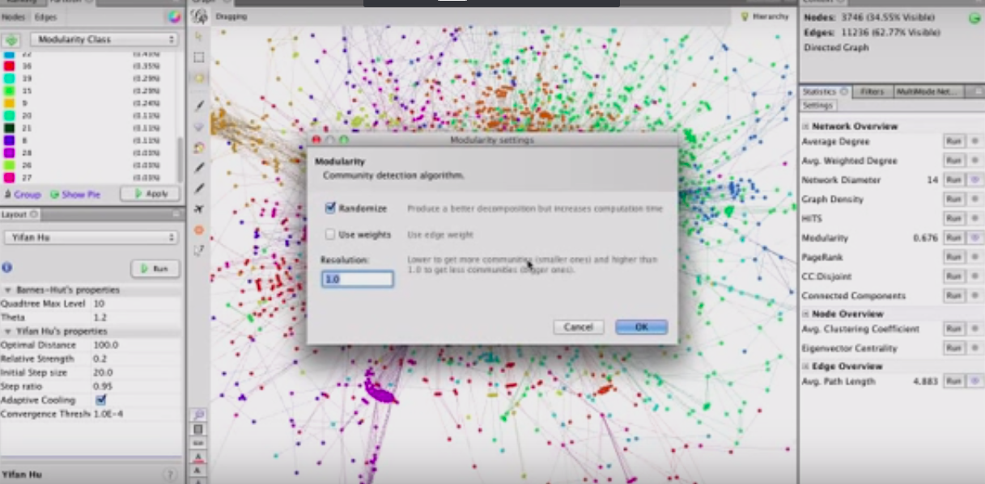
Partitioning continued
You can modify the modularity parameters on the right panel
You can individually change the colors of the communities in the right panel

Slide 12
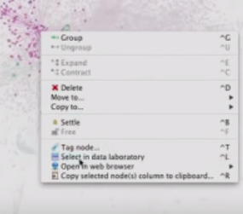
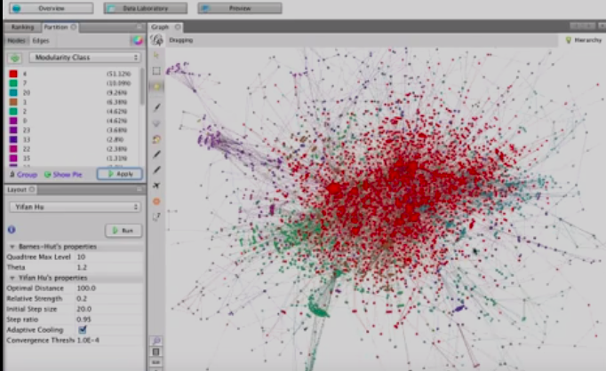
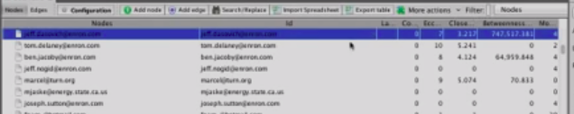
Partitioning continued
To view different communities, mouse over and right click then select open in data lab
You can see information about the cluster on the datalab tab and what cluster it belongs to
Then you can go back and change the colors on your graph to make it more clear

Slide 13
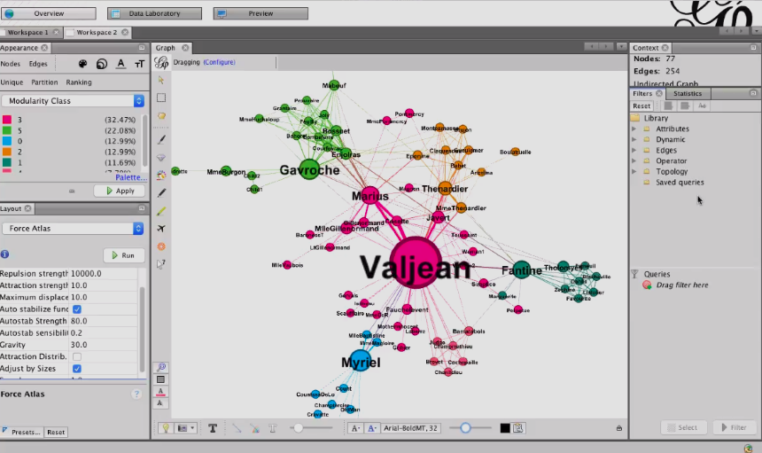
Setting labels
Click the label button at the bottom of the screen (T)
Click the A and select node sized
Drag the slider to resize labels

Slide 14
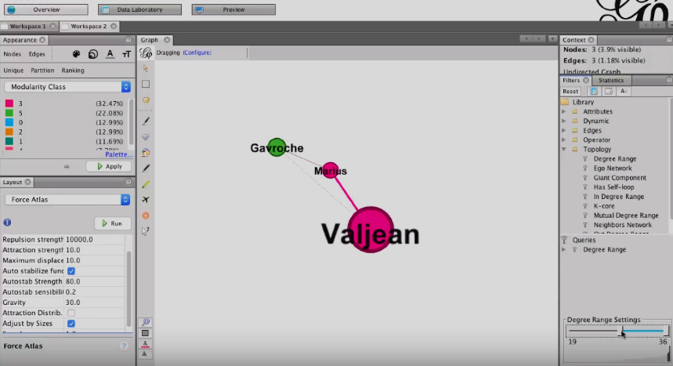
Applying filters
If you just want to view a specific set of nodes from your graph, you can drag filters in the filter tab to the query
Adjust the range with the slider and hit apply

Slide 15
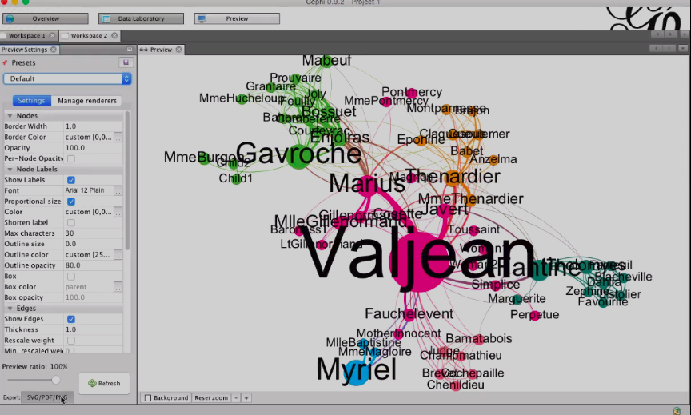
Export
Hit preview and apply whatever changes you want in the left column. Hit refresh for a preview
Then hit the export button at the bottom and choose your format.
You can also save it with file save as you would any file, and send it to people so they can continue adjusting teh graph off of what you already have

Slide 16
Networkx vs Gephi
Strictly speaking networkx is a more flexible tool with built in graph algorithms, a well tested and documented codebase, and minimal toolchain.
You can generate graphs in both networkx and gephi (file>generate>random), but gephi only lets you make one type of random graph, while networkx lets you specify (gnp, gnm, barbasi, etc.)
Networkx is python based while gephi is a java based tool
Gephi is more of a network illustration tool. It’s more intuitive for people who don’t know how to code, it also is easier to modify how your network looks quickly, and has a low learning curve.
Gephi is more interactive than Networkx, as you can directly interact with your graph, but anything gephi can do, there is a way to do it involving networkx (and possibly some other python libraries)
I guess the same could also be said about Gephi, because there are community based plug ins you can add to do more advanced analysis.
Anything more complicated than whats done in hw 1-3 are not very possible with gephi without plugins. (For instance, I couldn’t find a way to do permutation testing on gephi, although Im sure there are/it is possible to write plugins for that)

Slide 17
Summary/Other Gephi Features
I have covered most of the important features in the above slides, but here are some more things gephi can do:
It’s fast, you can make graphs of 100,000 nodes with 1000000 edges
As seen in the tutorial, you can change the layout/layout algorithms for graph readability, you can set metrics to visualize from your graph on the right, and you can also apply filters to view specific parts of your graph
You can do partitioning and temporal graphs, for more graph readability
If you click on Data Lab you can edit your imported graph data without messing up the format, which is actually really nice, not that you should be modifying your datasets after you collect them, but I guess if you want to experiment or create your own data
Importing and exporting to the format you want is “easier” (depends on what your preferences are)

Slide 18
Further Study
Explore plugins
Here’s a useful one I found that generates barabasi albert graphs https://gephi.org/plugins/#/plugin/generalized-ba-model-with-getting-old-nodes
There’s also some other layouts you can import https://gephi.org/plugins/#/plugin/circularlayout
Play with different software

Slide 19
Questions?

